Slide 1
MY FAMİLY

Slide 2
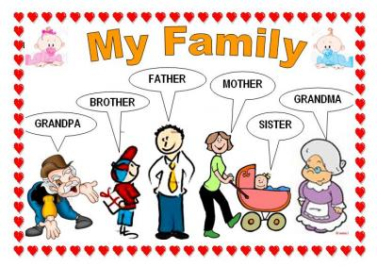
MY FAMİLY

Slide 3
Grandmother= büyükanne
Father=baba
Grandfather=büyükbaba
Mother=anne
Brother=erkek kardeş
Sister=kız kardeş
Daughter=kız çocuğu
Son=erkek çocuğu
Uncle=amca/dayı
Aunt= hala/teyze

Slide 4
NUMBERS

Slide 5
1= one2=two3= theree4= four5=five
6=six7= seven8= eight9= nine 10= ten
11=eleven12= twelve13=thirtteen14=fourtteen
15=fifteen16=sixteen17=seventeen18=eighteen
19= nineteen20=twenty

