Slide 1
Traffic rules

Slide 2
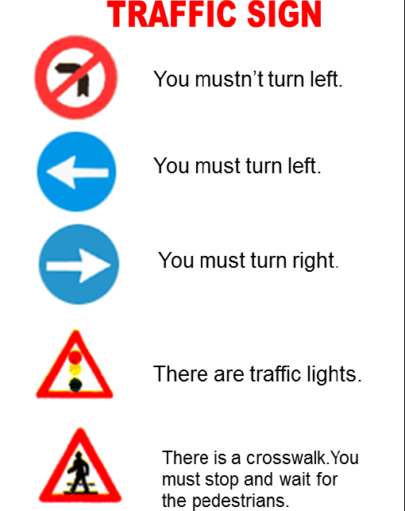

Slide 3
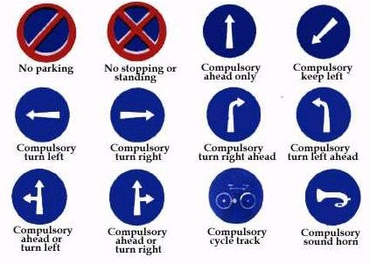

Slide 4
